Slide 1

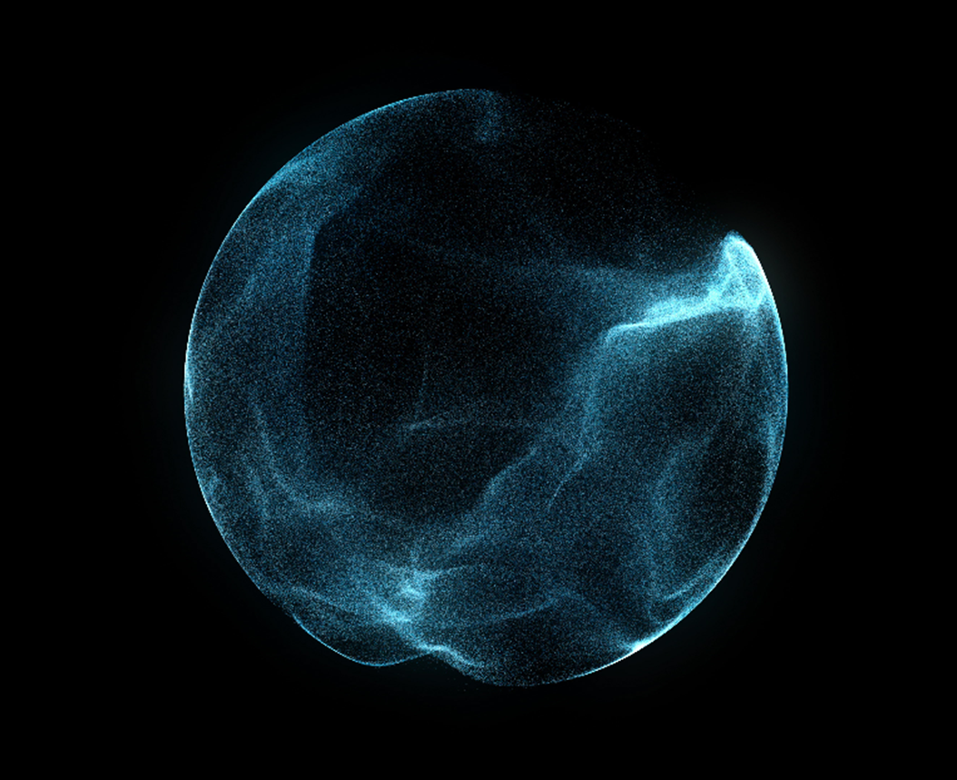
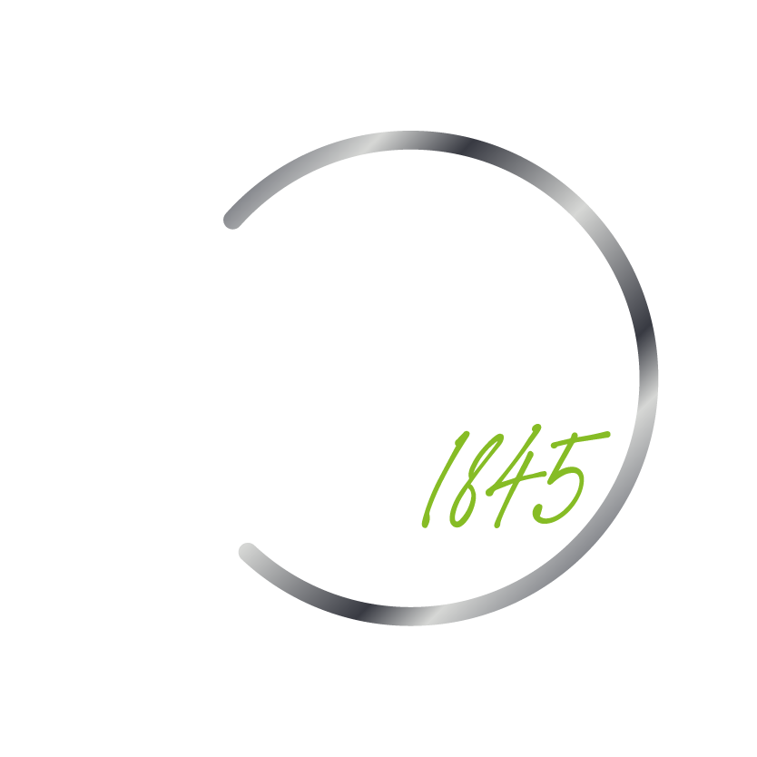

Slide 2
Creation of Tables and Structures
BOLTON HOUSE
© 2024. For information, contact Deloitte Touche Tohmatsu Limited.

Slide 3
Use Case Description
Sometimes for one development we have to create multiple tables/structures in Tcode - SE11 which is a tedious work. To ease it we can automate this process. For this we will provide some data in the excel in the form of rows and columns. Columns will contain the table names, Is TMG allowed?, Field names, data type, length, decimal and description Apart form these to create the table/structure we will default some data.
© 2024. For information, contact Deloitte Touche Tohmatsu Limited.

Slide 4
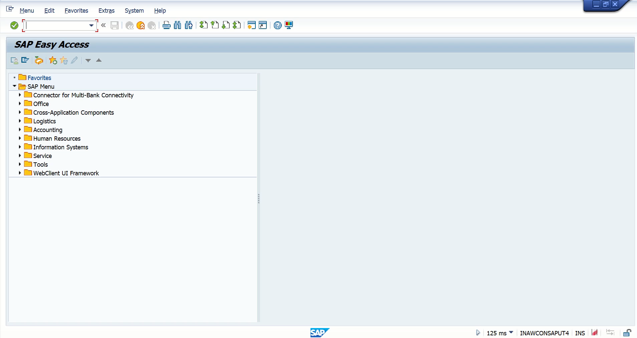
© 2024. For information, contact Deloitte Touche Tohmatsu Limited.

Slide 5
THANK YOU
© 2024. For information, contact Deloitte Touche Tohmatsu Limited.

